Slide 1




Reproducibility and dissemination in the research: a case of study of the bioaerosol dynamics
Jesús Rojo, Antonio Picornell, Jeroen Buters, Jose Oteros
jesrojo@ucm.es
Notes:
Hello everyone, I am Jesús Rojo from the Complutense University of Madrid, Spain. I am going to present the work “Reproducibility and dissemination in the research: a case of study of the bioaerosol dynamics”

Slide 2




AEROBIOLOGY
Public Health
Climate change
Crop production
Plant conservation
Notes:
Aerobiology is the research field based on the study of the content and dynamic of bioaerosols such as pollen or spores in the air. Findings are relevant for public health, crop production, plant conservation or climate change indicators.

Slide 3

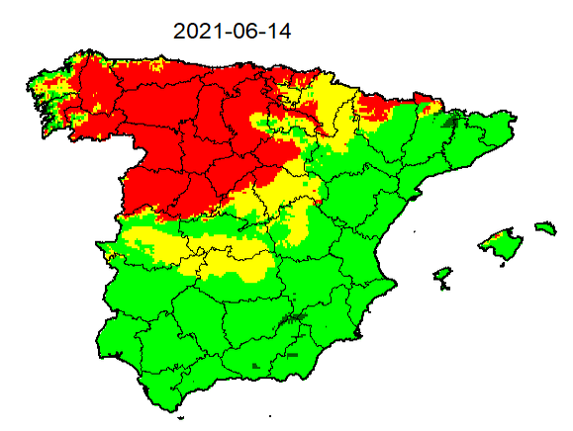
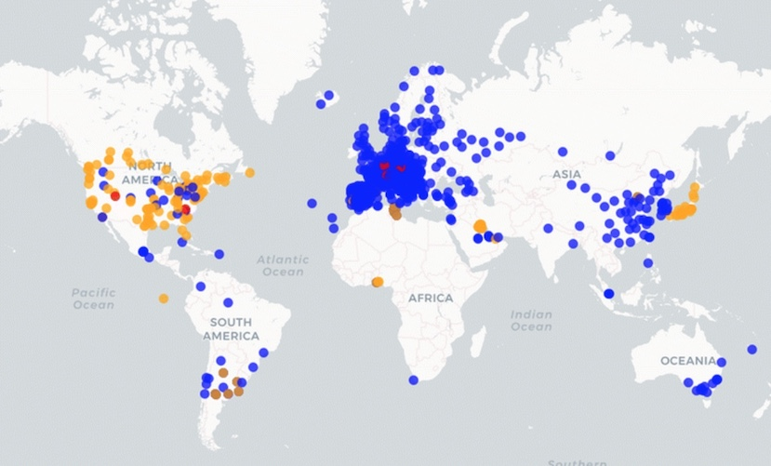

BACKGROUND
Pollen monitoring networks around the world are mainly based on rooftop-located stations on buildings
Aerobiological databases are constantly increasing which require dynamic computational tools to be efficiently managed
Grass pollen
Spanish Aerobiology Network
Notes:
The pollen monitoring networks have been extended around the world during the last decades.
For example, this is a map of pollen exposure used by the Spanish Aerobiology Network to disseminate information.
This map was generated using geostatistical techniques in R. And this map of the pollen stations around the world is a Shiny application implemented in R.
Aerobiological databases are constantly increasing which require dynamic computational tolos to be efficiently managed.

Slide 4
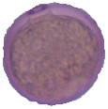
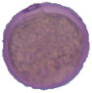
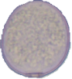

useR! in the research: Effect of height on pollen exposure
Aims of the research
Using R in the research
To estimate the near-ground vertical profile of pollen exposure based on a global study of paired stations located at different height
To determine the optimal height for the location of the sampling devices to get more representative data for relatively large geographical areas
Using R in large global databases allows to analyse data in a very efficient way
Programming tasks in the research procedure allows the reproducibility of the analysis
Different tools implemented in R allow to disseminate the results in a very interesting way
4
Notes:
Using R in large global databases allows to analyse data in very efficient way and allows the reproducibility of the analysis. In addition, different tools implemented in R allow to disseminate the results in a very interesting way.
In this talk, we show the use of R in the research, to estimate the near-ground vertical profile of pollen exposure based on a global study of paired stations located at different height. Also, we try to determine the optimal height for the location of the sampling devices to get more representative data.

Slide 5
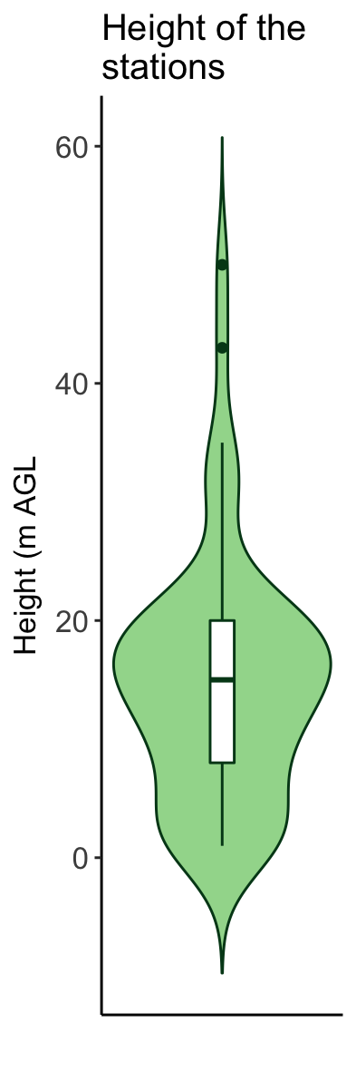
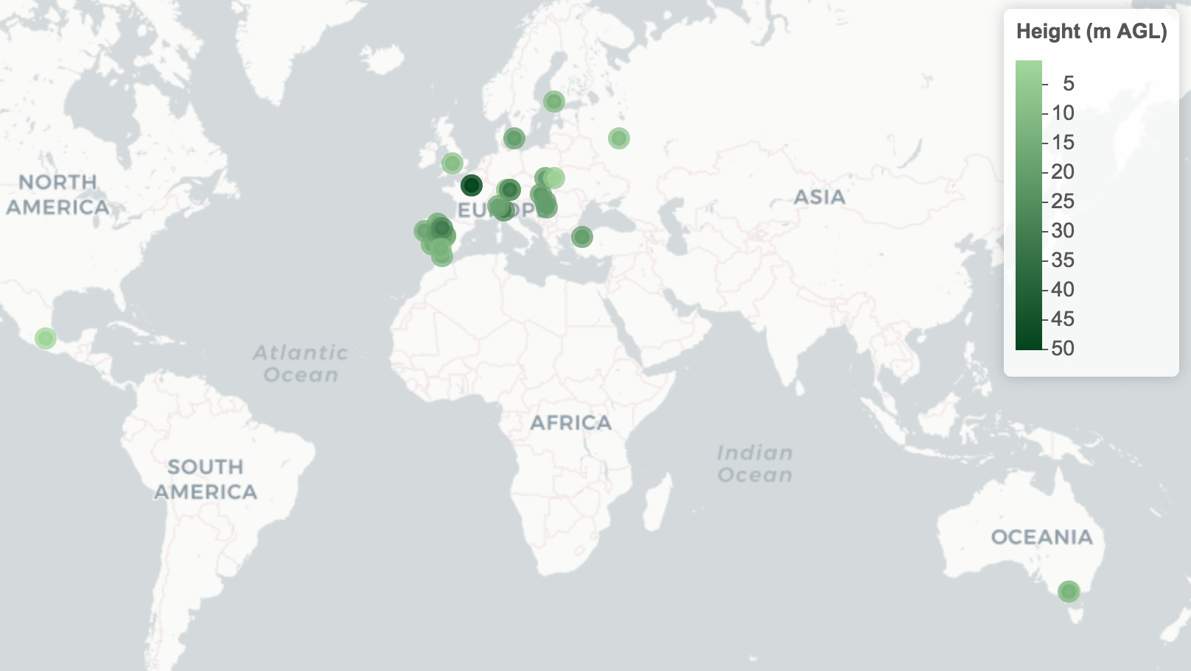
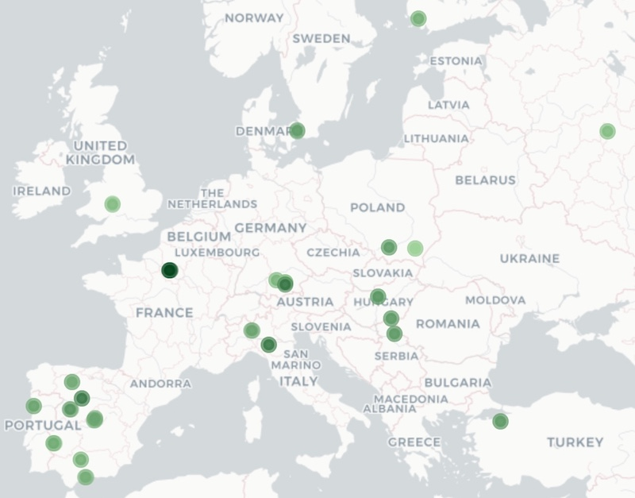

DATA PROCESSED
25 cities around the world
59 Hirst-type volumetric spore traps analyzed
Stations with a height between 1.5 and 50 m AGL
More than 2,000,000
analysed daily pollen concentrations
Europe
Notes:
In this work, we analysed more than two million of data, coming from 59 pollen paired stations. The paired stations were located between 1.5 and 50 meters above ground level and differences in pollen concentration between both stations were used to analyse the effect of heigh on pollen exposure.

Slide 6
FLOWCHART
Notes:
This is the structure followed to carry out this work. While we used simple techniques of analysis, we used a complex infrastructure of data that permited to incorporate new databases to update the entire analysis again.
First steps were based on processing the data and to apply a strict quality control, and after the analysis of the data, the results were disseminated using interactive applications related to a scientific publication.

Slide 7

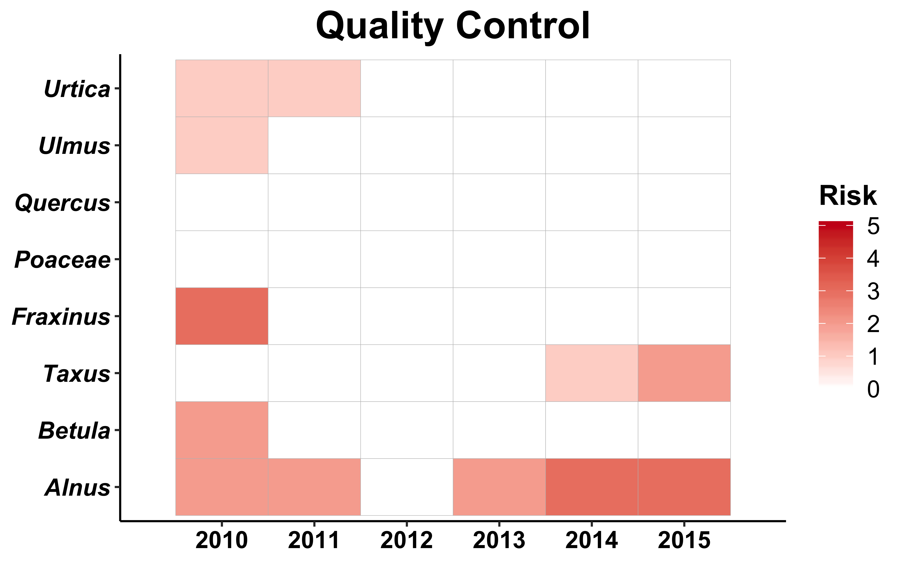







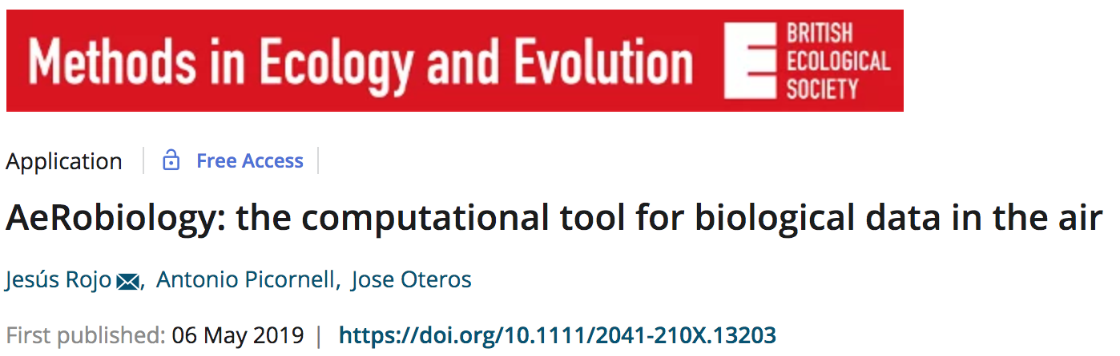
1) PROCESSING AND FILTERING OF DATA
Input of data
Checking the quality of data
Missing data
Low concentration
Non-representative data
Homogeneity of formats
Date
Pollen types
Notes:
We used the AeRobiology R package which implements function to check the quality of data and process the raw aerobiological databases. This tool allows checking the time-series for cleaning missing data, very low concentrations and non-representative data. Also we used the tidyverse tools to manage the databases.

Slide 8
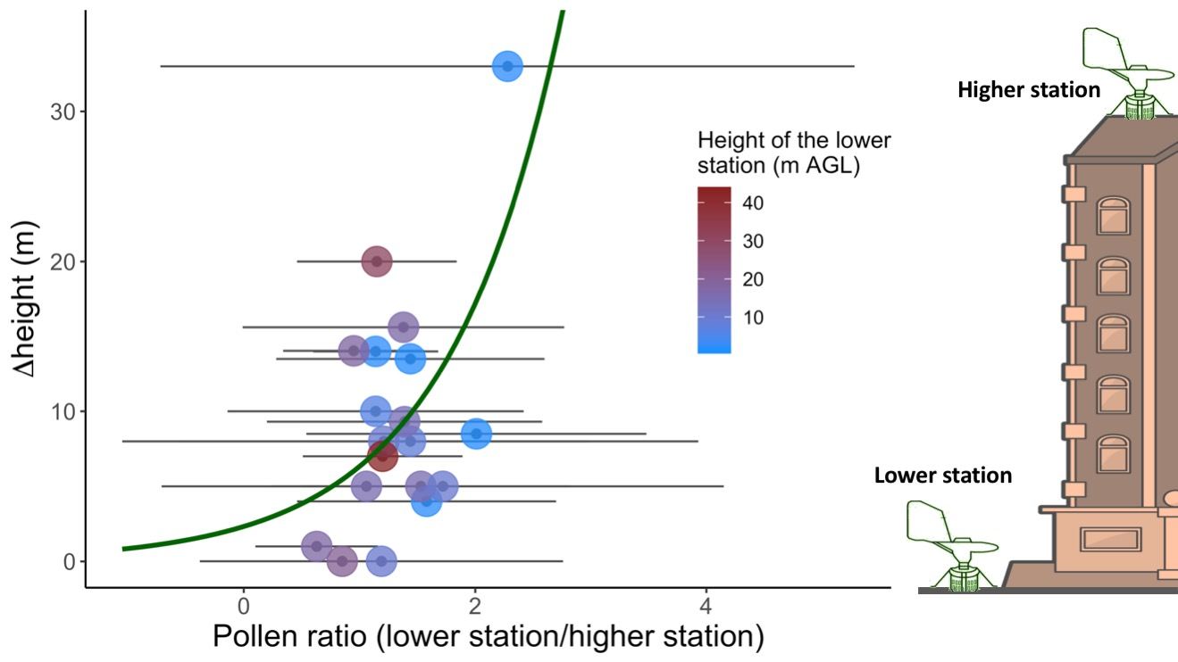

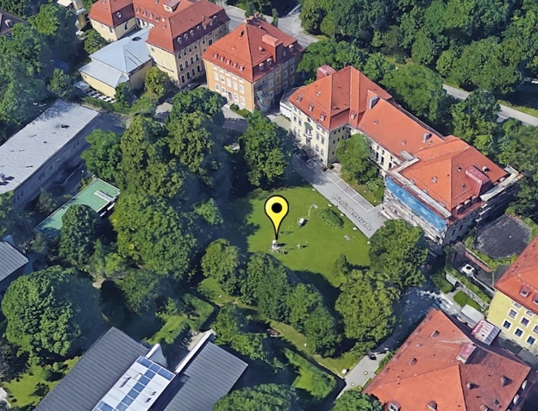
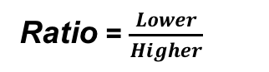
2) DATA ANALYSIS
Aggretating by paired stations
R system structured as lists of elements
Metadata (location, distance, height)
Data from higher station
Data from lower station
Ratio = $\frac{Lower}{Higher}$
Big Data analysis
Global-scale
Local-scale
The real pattern can be observed when a large amounts of data are analyzed. Factors influencing at local scale can mask the real effect of height on pollen sampling
Notes:
An infrastructure based on lists of elements allowed to incorporate the information required for the analysis, and in addition, data from new sampling points were easily included with new elements to replicate the updated analysis.
The main analysis was based on the calculation of the pollen ratio of the pollen concentration for the lower trap divided by the pollen concentration for the higher trap.

Slide 9
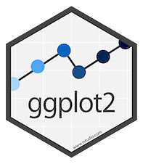
3) VISUALIZATION: VERTICAL PROFILE AND OPTIMISATION
Notes:
We applied elegant graphics using ggplot to show the main results. For example we obtained the vertical profile of the pollen ratio, or results to optimise the location of the pollen stations.

Slide 10
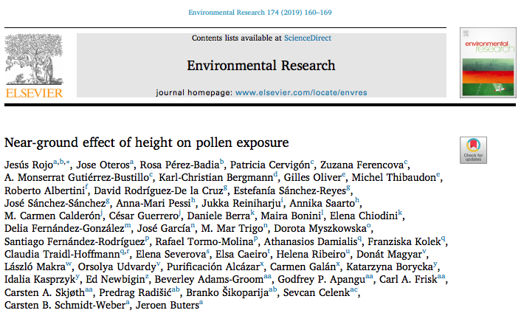

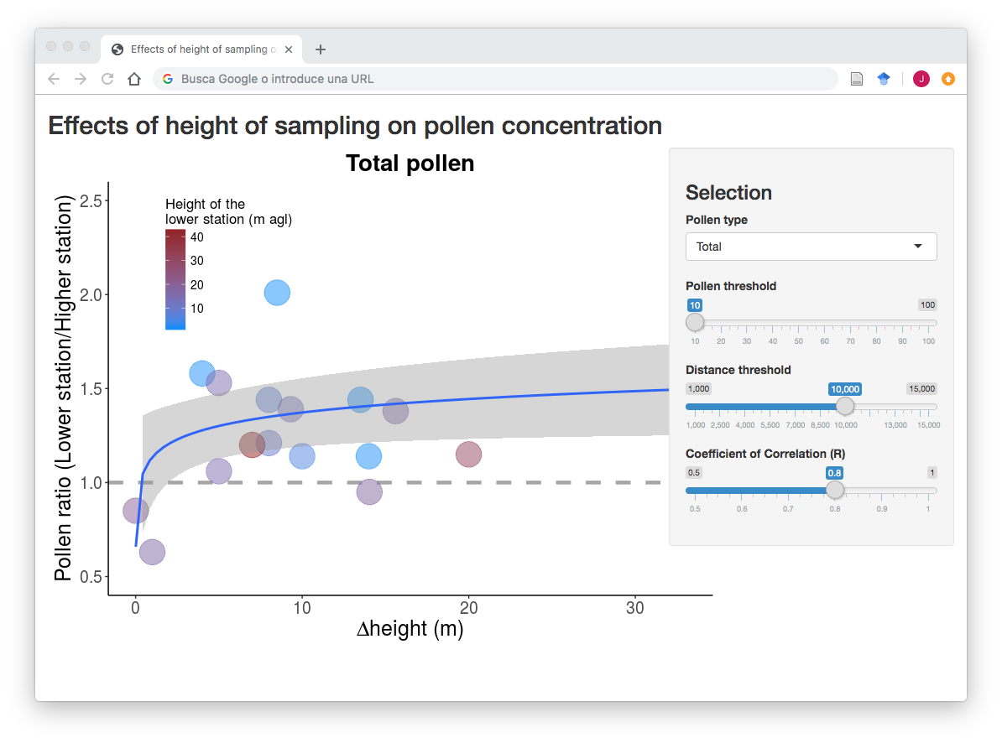
4) REPRODUCIBILITY AND DISSEMINATION
Programming language
1
Web-based applications
3
Supplementary material
Visualization
2
https://modeling-jesus-rojo.shinyapps.io/result_app2/
Notes:
As supplementary material of the scientific publication derived of this work, we generated a Shiny application based on ggplot visualisation

Slide 11
4) REPRODUCIBILITY AND DISSEMINATION
Customizable parameters
Select box and sliders
Pollen type
Minimum pollen concentration considered (to assure the quality of the data
Distance between paired stations
Correlation between paired stations (to assure the quality of the data)
https://modeling-jesus-rojo.shinyapps.io/result_app2/
Notes:
This application allows to disseminate better the results among the scientific audience and the public. In addition, the results may be reproducible changing important parameters such as the pollen type, the minimum pollen concentration, the distance between paired stations or the correlation between paired stations. Some of these parameters assure the quality of the data and the results.

Slide 12


THANKS!
Any questions?
jesrojo@ucm.es
The work was funded by ZAUM (Center of Allergy & Environment) of the Technical University Munich/Helmholtz Zentrum Munich and the Bavarian State Ministry of Health and Care
SlidesCarnival
Notes:
Thank you very much for your attention!

